Slide 1
Lesson 9: Designing a Reliable and Secure System
Notes:
Most of this content has been adapted from Sanjay’s Embedded Security Presentation: https://nitalk.natinst.com/docs/DOC-142196

Slide 2
Agenda (1)
Introduction
Security Layers
Recommended Best Practices
General
VI Server Access
NI Auth
Exercise 8.1: Protect cRIO by Restricting VI Server Access and Enabling NI-Auth
SSL
WebDAV
Exercise 8.2: Use WebDAV and Disable the FTP Server
RTEXE and FPGA Best Practices
Exercise 8.3: Implement a Safe State in an Existing Application

Slide 3
Agenda (2)
Intermediate Security Considerations
Hardware Restrictions
VPN
Certificates
Scan Mode
Extreme Security Considerations
Application Whitelisting
Software Checking
Hardware Checking
Encrypt Communication
Redundancy
Conclusion

Slide 4
1. Introduction

Slide 5
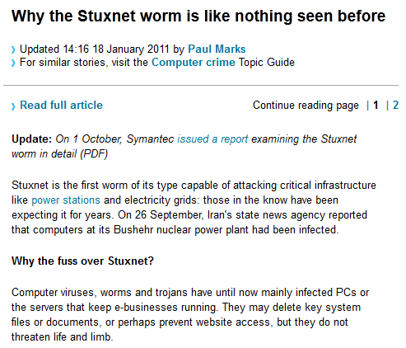
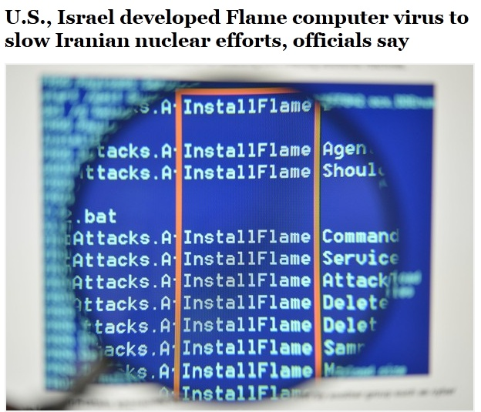
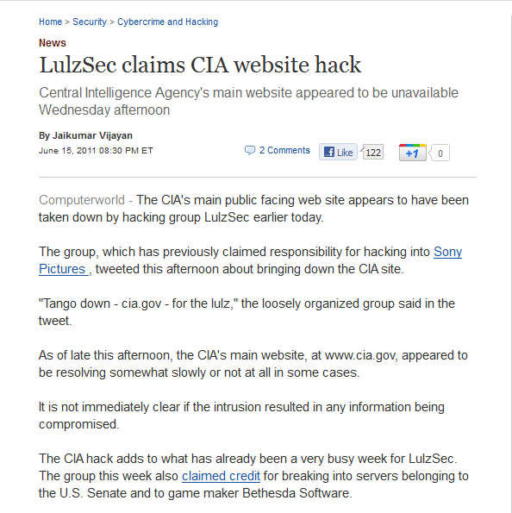
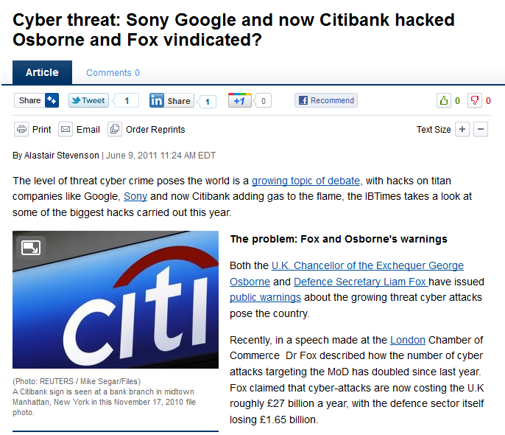
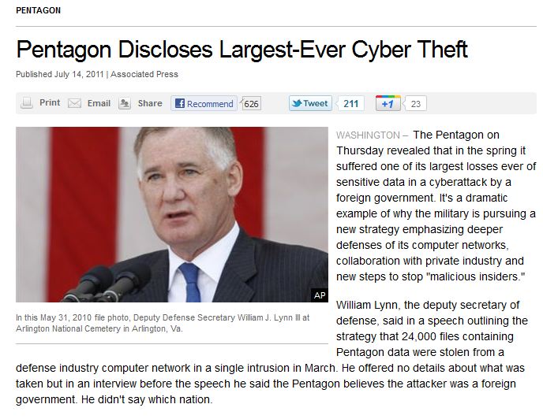
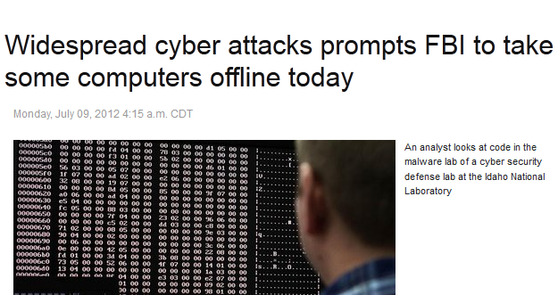
Why care about Security?
Notes:
[Instructor Note] Ask customers if they’ve heard of StuxNet, or if they have experience with computer viruses. Stress that viruses can affect embedded targets too.
Stuxnet was a virus that occurred in June 2010, and was designed to specifically attack Siemens Step7 software. Almost ruined 1/5 of the Iranian nuclear centrifuge by spinning it out of control, which replaying recorded system values which showed normal values during the attack.

Slide 6
Q: How much time should be invested in security?
Notes:
Given the current state of affairs – lots of cyber attacks, etc. Am important question to consider is how much time and effort should be invested in security?
Give a moment’s pause to let this question sink in. It’s not just about going all-out and spending every last dollar on security…

Slide 7
Balancing Security with Other Constraints
Decision based on level of risk, impact, liability, etc.
Security
Ease of Use
Time & Cost
Notes:
… instead, it’s about balancing security with other constraints. Notably, to make a system more secure, it will come at the expense of ease of use (users have more logins, making changes to the system will force you to potentially roll back security oversight features etc.). On top of it all, implementing security takes time and costs money.
The “right answer” is that the investment in security should scale with the application. If you have a non-critical application, and the risk associated with compromise is low, then you can spend relatively little on security. Alternatively, if you have a very critical application that has a lot of risk and liability, you’ll want to invest a lot into security.

Slide 8
Security is a Shared Responsibility
You: Define security objectives, assess application-specific risks, evaluate and implement security steps
NI: Provide best practices, provide security features that enable deployment in your threat environment, listen to your feedback for the future
We want to work with you to tackle this complex challenge.
Notes:
What NI offers is to stand by users in addressing security. It’s the user’s responsibility to determine appropriate security needs for their application.
NI can work with the user to provide best practices, such as the ones outlined in this presentation, and work with users to make products that better enable security. NI is also open to feedback and is committed to keeping channels of communication open regarding security.
The idea is that together, NI and Users can work to address security concerns.

Slide 9
2. Security Layers

Slide 10
Layered Model of Security
Security can be defined at many layers
A breach at any layer can compromise other layers
“Don’t invest in a retinal scanner for your house if you are going to leave your window open”
“Defense in Depth”
Notes:
Before diving into the security vectors, mention that it’s useful to understand how security is structured. Given that computing is composed of layers, security too follows suit with layers.
The outermost layers are Network and Physical, and these represent the layers at which threats can originate. One a threat makes it in from the Network or Physical layer, it then needs to go through the Operating System. If the thread is able to penetrate the operating system, then all that remains is your application.
By having some amount of security at each layer, you protect yourself well against threats. This way, even if a threat makes it past one layer (say Network), then with some security at each layer it can be stopped (say by the OS). It’s important not to spend all your time and effort securing one layer and not addressing other layers. If a threat somehow makes it past the layers you have spent all your effort on or makes in in from elsewhere, then without security at each layer, your system will be compromised! It’s better to invest in some security at each layer.

Slide 11
Layered Model of Security
P
O
A
N
Physical Layer
Operating System
Application
Network
Notes:
This diagram is referenced in many places in the slides. This is an introduction meant in familiarize customers with the layers of security. They will be explained in more detail in the following slides:
Network
Physical
OS
Application
[Instructor Note]: Consider tying this explicitly to the waveform datalogger example we've mentioned several times through.

Slide 12
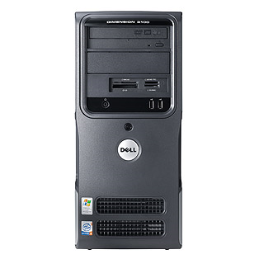
CompactRIO Security Vectors
Ethernet
Development and/or Deployment PC
CompactRIO Embedded System
Notes:
This is what a typical RIO system looks like. You have a host pc (which may or may not be the dev. Pc) and a cRIO. Generally, the two are connected over a network.
Security layers mapping to the host pc:
Network: these are threats that can emerge from the network you are connected to. If the host pc is connected to the Internet, then attackers from anywhere in the world can assault your system.
Physical: these are threats such as someone plugging in a usb stick, or taking the computer apart and stealing the hard drive, or simply getting physical access to the operator interface and manipulating the controls to disrupt the system.
OS: commonly, the OS is some version of the windows OS. It’s important to consider that the OS may have vulnerabilities that can affect your application’s security. Mention Linux RT benefits.
Application: at the heart of it all is your application. You may want to consider your application’s footprint as well as the technologies that your application is relying on to understand the security risks that your application enables.
Similar to the host pc, the RIO device has layers of risks as well.
Mention that the OS on the RIO is currently a Pharlap or ETS OS. Also mention that all the best practices outlined apply to both OSes (Pharlap and ETS).
Mention that in the case of the RIO device, one unique feature is that the FPGA gates all of the I/O. The FPGA is thus a ‘critical’ link between the RIO device and any hardware you have downstream of the RIO device.
Mention that the RIO device can be subject to threats from the network just like the host pc. Also mention that unlike the host pc, Pharlap and ETS don’t have a software firewall, making it a more vulnerable network target.

Slide 13
3. Recommended Best Practices

Slide 14
General Best Practices
P
O
A
N
Anti-Virus
OS Updates/Accounts
Network Firewall
Isolated Network
Use an isolated network if at all possible to connect the system
Use a software or hardware firewall to filter packets on certain ports and prevent select applications from accessing the network. Use both for greatest benefit.
Keep the OS patched and updated to reduce vulnerabilities
Use an account with limited privileges (not Administrative)
Use Anti-Virus to detect and clean infections
Notes:
First measure is to implement a network firewall on the host pc. Use both a hardware firewall and the built in software firewall (which exists on most common OSes, such as Windows) for maximum security.
The article referenced provides information about what ports are used by NI software so that users can filter out other ports with the hardware and software firewalls.
The advantage provided by the hardware firewall is that most modern hardware firewalls have the ability to prevent common attacks (such a Denial of Service attacks), and can inspect packets of data to make sure that they are not malformed (indicative of some types of attacks).
In addition to a network firewall, it’s good to keep the OS updated/patched so that attackers don’t get in by using known vulnerabilities. Setup user accounts with limited privileges so that even if attackers gain access to the operating system, they don’t have Administrative rights, and are limited to the permissions that the user has.
Running an Antivirus program will also help you detect and clean any infections.
[Reference] – On HW/SW Firewalls: http://home.mcafee.com/advicecenter/?id=ad_ost_hvsf&ctst=1

Slide 15
General Best Practices
P
O
A
N
Remove Block Diagram
Build EXEs
Remove the block diagram: LabVIEW Help: Removing Block Diagrams from VIs
Use Build Specifications such as EXEs and remove the source code from deployed systems
Remove LabVIEW Development environment
Notes:
At the application level, it’s good to set passwords on important VIs that you want to protect (which contain key algorithms etc.). This provides an additional security measure that attackers must overcome if trying to steal IP.
Demo: Go to LabVIEW. File -> VI Properties -> Protection
Also, build the host pc code into an EXE and remove the source code off the machine. This way, attackers can’t just copy the .VI files off the host pc to learn more about the application. It’s a lot more work to decode the EXE binary, which isn’t hard to build. Using an EXE provides an additional level of security over keeping the source code on the computer and running the application out of the development environment.
Demo: Open Security Project, Create Build Spec -> Go to Source File Settings → Remove block diagram
[EDIT]: Add Dev Env to diagram

Slide 16
Manage VI Server Access
P
O
A
N
VI Server Access
Manage VI Server (TCP) Access to prevent ‘LabVIEW’ viruses
Prevent attackers from remotely accessing and running code on your PC or RT target
Notes:
In addition to setting passwords and building an EXE, be sure to manage VI Server access if VI Server is enabled.
By default, the access list for VI server is *, meaning anyone can access VI Server! This means that attackers can launch “LabVIEW viruses”. By properly managing the accessing settings for VI server, you can prevent attackers from remotely targeting the LabVIEW environment or any of your VI remotely (for example, attackers won’t be able to run malicious VIs that they may have written remotely on your computer).
[INSTRUCTOR NOTE] Implementation taught through exercise (8.1B)

Slide 17

What is NI Auth?
A service that manages authentication and authorization for NI hardware
It is important to configure NI Auth settings on both the RIO target and the host PC
If NI Auth is not configured, attackers can use the WIF to access the filesystem on the RIO target and upload, download, and modify files on the RIO target
Notes:
Talking points:
NI Auth – Authentication and Authorization
Important to set up. If not, opens up to major vectors of attack
Can reformat/reboot etc
Analogy: A lot like setting no password on Windows
If you leave your laptop somewhere, you’re screwed.
[Source] https://protect.iu.edu/cybersecurity/authn-authz
Authentication vs. Authorization
In computing systems, authentication and authorization must work in tandem to provide effective security. Without authentication, there would be no way to determine if individuals are who they claim to be. Without some sort of authorization in place, it may not matter who they claim to be — as with no authorization in place, essentially anyone could access anything simply by telling the truth about who they are.
Authentication
Authentication is the process of determining whether someone or something is, in fact, who or what it is declared to be. To access technology services you must provide such proof of identity.
In private and public computer networks (including the Internet), authentication is commonly done through the use of login passwords or passphrases; knowledge of such is assumed to guarantee that the user is authentic. Thus, when you are asked to "authenticate" to a system, it usually means that you enter your username and/or password for that system.
Authorization
In computing systems, authorization is the process of determining which permissions a person or system is supposed to have. In multi-user computing systems, a system administrator defines which users are allowed access to the system, as well as the privileges of use for which they are eligible (e.g., access to file directories, hours of access, amount of allocated storage space). Authorization can be seen as both the preliminary setting of permissions by a system administrator, and the actual checking of the permission values when a user obtains access. Authorization is usually preceded by authentication.

Slide 18
NI Auth
P
O
A
N
Turn off console
NI Auth
Access and set an NI Auth password using the Web Based Configuration and Monitoring Interface
Remove support for the ‘everyone account’
NI Auth Users and Passwords:
Sync with Linux users on NI Linux Real-Time Targets
Sync with the FTP password on Phar Lap and VxWorks targets
Notes:
It’s also important to configure NI Auth settings on both the RIO target and the host pc. NI Auth secures the Web-based configuration and monitoring tool (WIF) as well as changes from MAX.
If you don’t configure NI Auth, attackers can use the WIF to access the filesystem on the RIO target and upload, download, and modify files on the RIO target. Attackers can also reboot the target. This means that through the WIF, an attacker can load their own .RTEXE and reboot the RIO to load their application instead of yours!
Additionally, without NI Auth, attackers can install MAX on their computer (MAX is free and installs with any of the driver sets), and can then change the software that’s installed to your RIO target!
[INSTRUCTOR NOTE] Implementation taught through exercise (8.1B)
NI Auth had some limitations on Pharlap and VxWorks. For FTP Server, NI Auth would protect this, but literally nothing else. There is no concept of permissions for those OS’s. It’s because it is all flat memory, no kernel. When you set a password and authenticate your password, it gets send over plain text. Sniffing the wire will expose the password. On Linux, this is not an issue. NI Auth is a separate service on Linux, but syncs with everything that happens on the OS.
NI Auth uses a protocol called SRL. Password not stored on target. Stores a hash. Encrypted hash sent over. Very hard to break SRL. SRL → Encryption method.

Slide 19
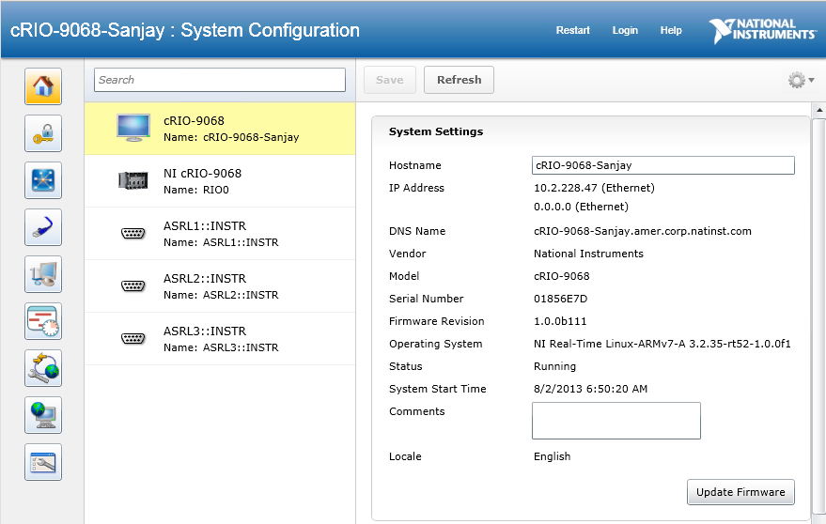
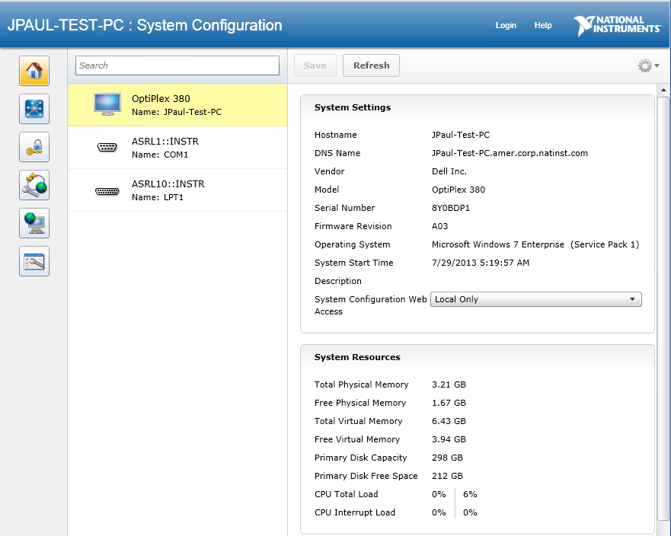
NI Auth
P
O
A
N
Web Based Configuration and Monitoring (WIF)
cRIO:
http://<cRIO_ip.addr>
Note: Port 3580 is now just for listing services!
http://<cRIO_ip.addr>:3580
Host PC
http://<host_ip.addr>:3582
Notes:
To access and set NI Auth settings, you must get to the WIF. Open a web browser and point to the addresses shown to get to the WIF.
Note: You have to install NI Web-based configuration for it to be present on the RIO target. When you select Web-based configuration, the Web-based configuration network support is also installed onto the RIO target.
Port 3580 is just the service locator. On cRIO, just enter the IP address

Slide 20
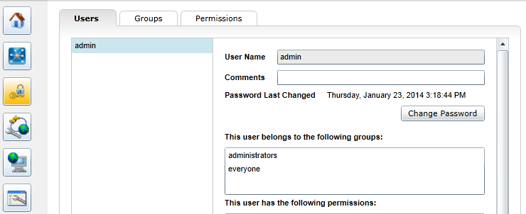
Activate NI Auth
Security Configuration
Notes:
Security Configuration

Slide 21
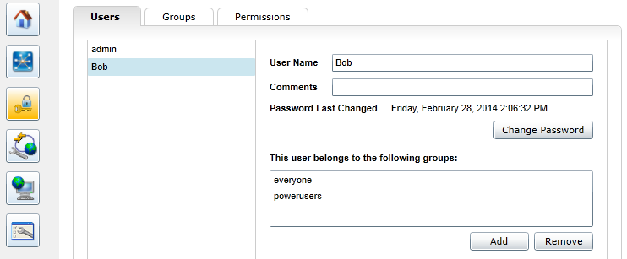
Add New Users and Groups

Slide 22
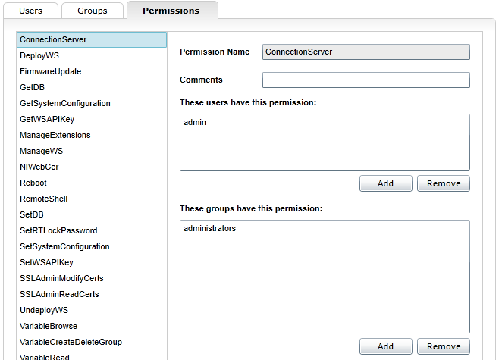
Create Permissions

Slide 23
Exercise 8.1
Protect cRIO by Restricting VI Server Access and Enabling NI-Auth

Slide 24
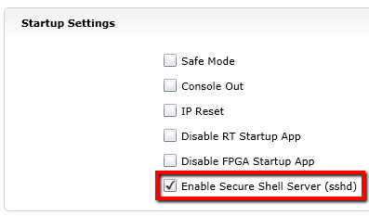
Demo: NI-Auth on NI Linux Real-Time
P
O
A
Note: admin account is superuser on Linux
PAM will replicate NI-Auth users to NI Linux Real-Time
Consider turning off SSH on NI Linux Real-Time targets
Do not install or use unsecure FTP on NI Linux Real-Time
Use WebDAV instead (and/or SFTP if you have to keep SSH enabled)
N
Notes:
Once you login, you can click on the lock and key icon to setup access settings, permissions, etc. The first order of business here is to be sure to change the password for the admin account to something other than the default blank password.
This is what you should be doing with NI Auth. Ultimately, you want to make sure that each user who has access to the RIO device over the network is limited to the functionality that they need and nothing more. This way, you mitigate the security vulnerabilities presented by the WIF functionality.
PAM = Pluggable Authentication Module, bridges NI-Auth with Linux permissions. Piggyback off of the security of Linux.

Slide 25
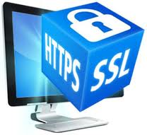
What is SSL?
SSL = Secure Sockets Layer
SSL: An encryption method
Uses X.509 certificates to establish secure connections between a client and a server
Certificate: digital files that contain identifying information about the server, as well as a public key and a digital signature
When a client attempts to establish a secure connection to the server, the server provides this certificate
The client confirms the authenticity of certificate, often using a major Web browser
Notes:
[REFERENCE] http://zone.ni.com/reference/en-XX/help/371361K-01/lvconcepts/ssl_security/
[REVIEW] Rules for images?
[EDIT] Concept is encryption. Slide on encryption instead of SSL?

Slide 26
SSL
P
O
A
N
SSL
Enable SSL on System and Application Web Servers
Communication between cRIO and host pc is secured by SSL
Need to build a Web Service to make use of SSL on App Web Server
Notes:
In addition to managing NI Auth settings, you can use SSL enabled web services to securely pass data from the real-time controller to the host pc. While you can go through the trouble of encrypting the data on both ends before transmitting over the network and decrypting on each end, it’s much easier to rely on an SSL enabled web service to securely transfer data.

Slide 27

Client
Server
Web
Service/ Resource
Open Connection
SSL Certificate
NI Auth Credentials
Key
Endpoint
Endpoint

Slide 28
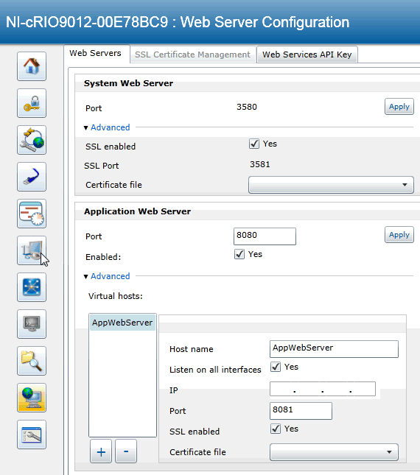
Demo: Enable SSL
P
O
A
N
Enable SSL for both System and Application Web Servers
Note: SSL is enabled by default on NI Linux Real-Time
Select and setup self signed certificates or go through a CA
Notes:
To enable SSL, go to the WIF, and click on the icon with the globe and the computer to configure the web servers.
You can enable SSL on both the System web server (which hosts the WIF) and the application web server (which will host the web service you build)
[Instructor Note]: For demo purposes I am using the LabVIEW default certificate. In practice, you should not use this.

Slide 29
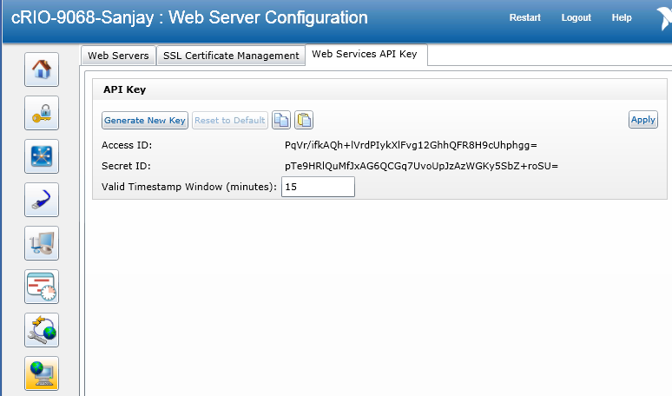
Demo: Enable SSL
P
O
A
N
Enable SSL for both System and Application Web Servers
Note: SSL is enabled by default on NI Linux Real-Time
Select and setup self signed certificates or go through a CA
Configure API Keys on Web Services to protect against replay attacks
Notes:
To enable SSL, go to the WIF, and click on the icon with the globe and the computer to configure the web servers.
You can enable SSL on both the System web server (which hosts the WIF) and the application web server (which will host the web service you build)
API Keys: Unique UID that prevents replay attacks. Time sensitive, and you can set the time interval. Example: if you send the same command twice to a control system, this could be very bad.

Slide 30
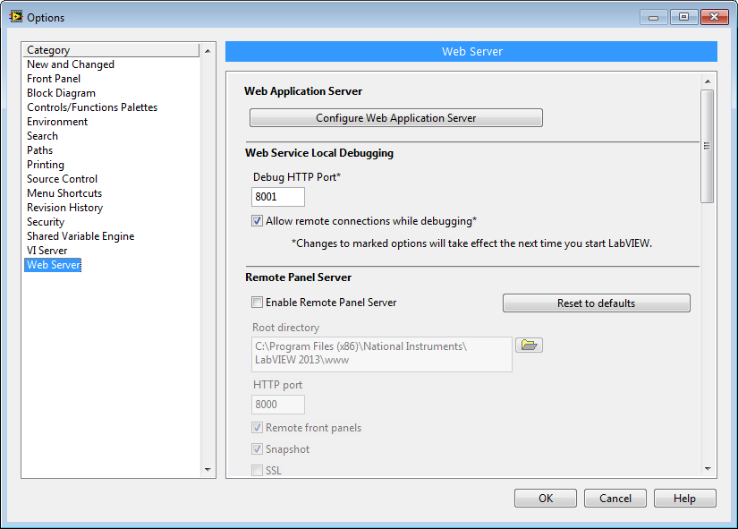
Activating SSL
Tools » Options…
Notes:
LabVIEW ships with two built-in web servers (system and application). You configure SSL and NI Auth for your web services through the Web Interface Framework.

Slide 31
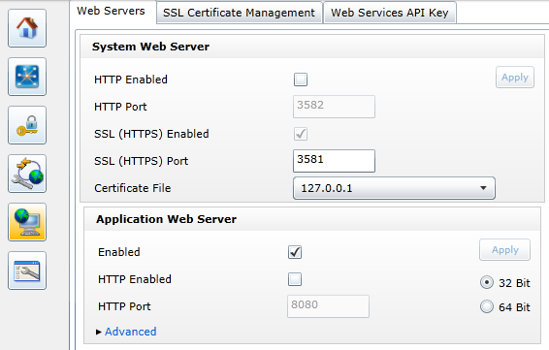
Activating SSL
Web Sever Configuration
Notes:
Web Server Configuration

Slide 32
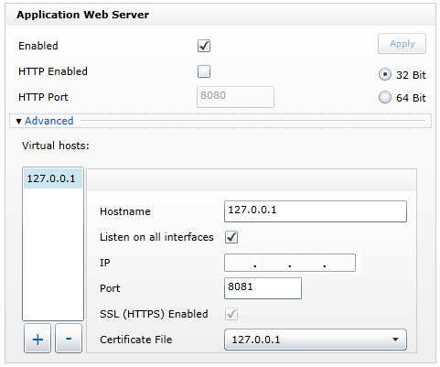
Activating SSL
Notes:
Note to self: certificate must match host name. Does “hosthame” have to match certificate name?

Slide 33
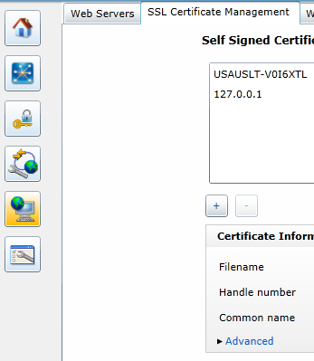
SSL Certificates

Slide 34
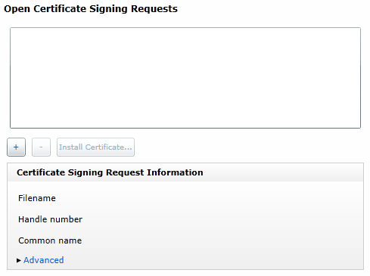
Create a Certificate Signing Request

Slide 35
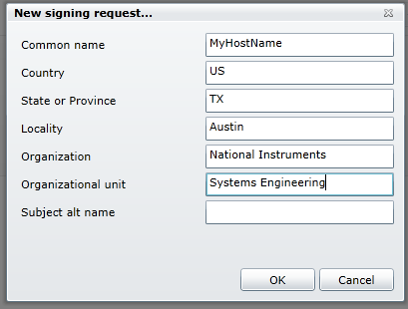
Create a Certificate Signing Request
Notes:
See question on slide 28

Slide 36
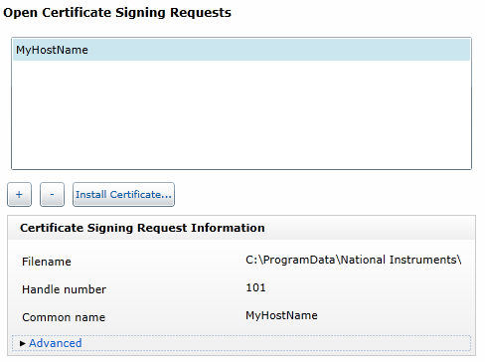
Create a Certificate Signing Request

Slide 37
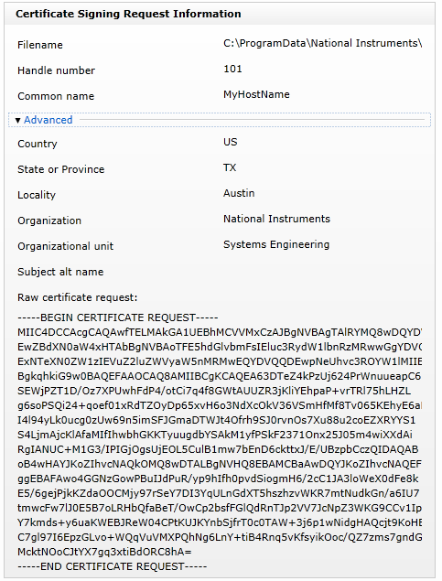
Create a Certificate Signing Request
Notes:
This is the text you send to Verisign

Slide 38
Create a Certificate Signing Request
Notes:
Click on Install Certificate. Browse to your signed .cer file to install

Slide 39
Activating SSL
Notes:
Now you can add the certificate to your system and application web server.

Slide 40
System Web Server and SSL
P
O
A
N
Accessed by: https://<ip.addr>:3581
See: Securing the Web Server with SSL (Windows)
Create Self-Signed SSL Certificates with Distributed System Manager
Pharlap and VxWorks Caveat:
Can’t access SSL component files from the filesystem
Must use Distributed System Manager for CSR and Self-Signed Certificates
Notes:
Note that the SSL enabled system web server will reside on port 3581. The link to the documentation can be used for more info and securing the web server with SSL.
Caveat section:
Issue: Pharlap and VxWorks, need to use DSM to create self-signed certificates. Need to jump through extra hoops to create self-signed certificates on Pharlap and VxWorks. Key message: easier on Linux.

Slide 41
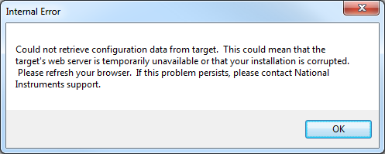
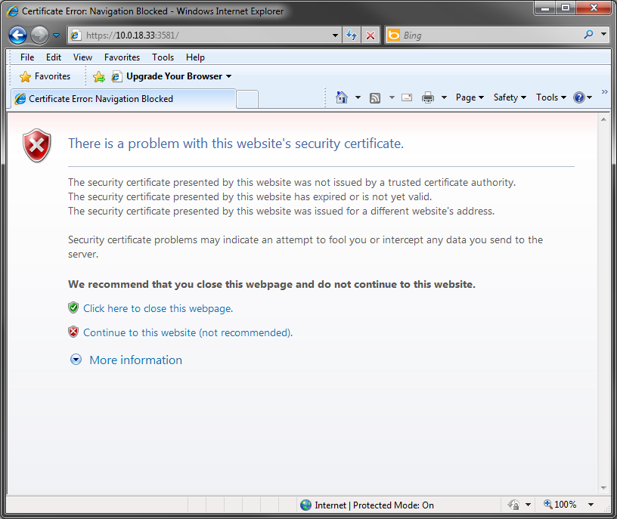
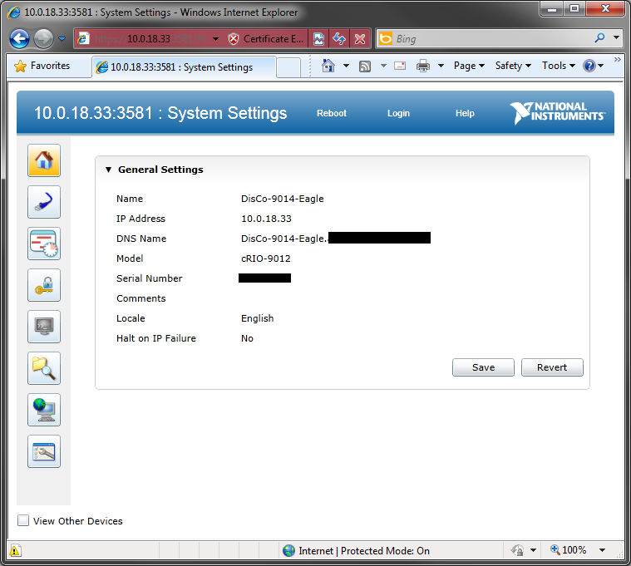
System Web Server and SSL
P
O
A
N
Use Internet Explorer
Firefox & Chrome not currently supported
Notes:
Also note that to access the SLL version of the system web server, you need to use Internet Explorer. Other browsers error out. The URL has to have https. Don’t forget the ‘s’!

Slide 42
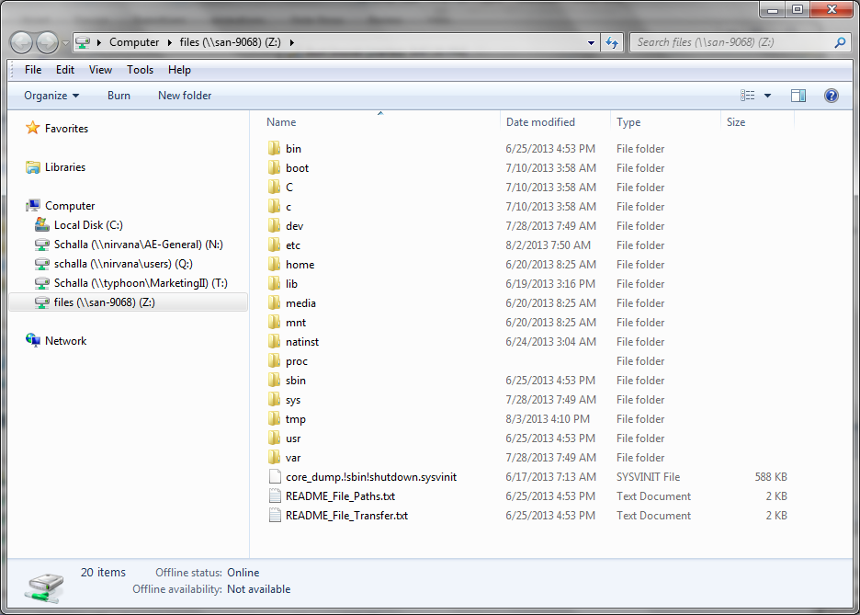
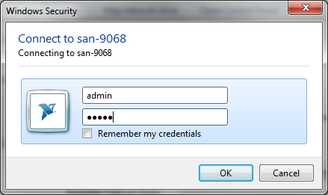
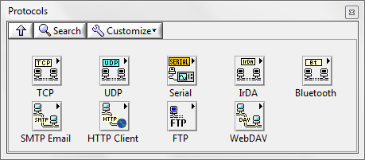
What is WebDAV?
Industry Standard Protocol
Manage files on targets remotely over HTTP
Secure File Access
Authentication
Encryption
Supported by all OSes and Web Browsers
New LabVIEW API for programmatic access
Notes:
** Optional include if you have time – one slide outside of the Linux RT slides related to new LabVIEW 2013 Real-Time Module features **
Main Message:
LabVIEW versions 2013 and later include the WebDAV VIs to help you transfer files securely to and from a WebDAV server. You can use the WebDAV VIs to programmatically store, edit, and manage documents and files stored on your target, and to access advanced functionality, such as obtaining directory and path information, viewing the progress of an upload or download request, starting requests in parallel, and processing requests in response to a user interface event.
===============
Details:
WebDAV = Web Distributed Authoring and Versioning
================
Additional Resources:
Learn more about how to setup WebDAV and the LabVIEW 2013 capabilities here:
http://ae.natinst.com/public.nsf/web/searchinternal/4ebe45e8a816b19386257b6c0071d025?OpenDocument

Slide 43
WebDAV and the FTP Server
P
O
A
N
Disable FTP, use WebDAV
Use WebDAV for file transfer
Disable the open FTP server on non NI Linux Real-Time targets
Caution! Disabling the FTP server prevents new drivers from being installed to the controller
Caution! The FTP server will still function in Safe Mode
Notes:
In addition to using SSL enabled web services to securely pass data, users can also disable the open FTP server that is on RIO targets and put the RIO on a secure, internal network.
There are some caveats to disabling the FTP server – the most critical is that you can’t install new things to the controller if the FTP server is disabled. To disable to FTP server…

Slide 44
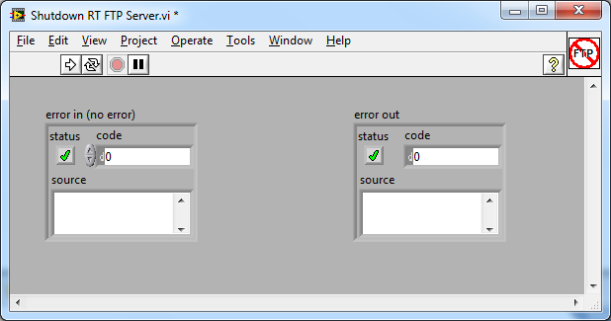
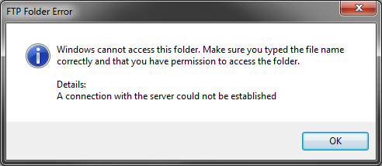
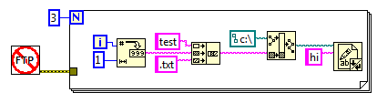
Disabling the FTP Server
P
O
A
N
Shutdown RT FTP Server VI
Must reboot system to enable FTP server
Works on VxWorks and Pharlap
Non-Issue on NI Linux RT
Use when initializing RT application
Disable RT Startup App to enable FTP
Notes:
Use the Shutdown RT FTP Server VI. There is a devzone on the topic, at: Best Practices for Security on RIO Systems: Disable Real-Time FTP Server (http://zone.ni.com/devzone/cda/tut/p/id/13284).
This is a nice tool that makes disabling the FTP server easy. Use it during the initialization portion of the real-time application. To get your FTP server back, disable the RT App using the DIP switch on the cRIO and reboot the cRIO. Alternatively, you can push a new RTEXE onto the cRIO using the WIF or delete the RTEXE file from the WIF and reboot the controller for the FTP server to come back.
The goal is to have short periods of vulnerability (such as when pushing a software update to the cRIO) during which the FTP server is on, and having the FTP server turned off for the majority of time (when not in use).
Linux does not have an unsecure FTP server. SFTP over SSH. WebDAV instead (not only option). MAX uses HTTP. Can do over HTTPS.

Slide 45
Preventing Safe Mode
P
O
A
YouOnlyLiveTwice token:
Can be accessed from ni-rt.ini
Sets whether the controller boots into safe mode after two crashes or not.
For VxWorks and Pharlap only
NI Linux RT has a secure safe mode
N
Notes:
Use the Shutdown RT FTP Server VI. There is a devzone on the topic, at: Best Practices for Security on RIO Systems: Disable Real-Time FTP Server (http://zone.ni.com/devzone/cda/tut/p/id/13284).
This is a nice tool that makes disabling the FTP server easy. Use it during the initialization portion of the real-time application. To get your FTP server back, disable the RT App using the DIP switch on the cRIO and reboot the cRIO. Alternatively, you can push a new RTEXE onto the cRIO using the WIF or delete the RTEXE file from the WIF and reboot the controller for the FTP server to come back.
The goal is to have short periods of vulnerability (such as when pushing a software update to the cRIO) during which the FTP server is on, and having the FTP server turned off for the majority of time (when not in use).

Slide 46
Exercise 8.2
Disable the FTP Server on cRIO
Notes:
[EDIT] And verify

Slide 47
RTEXE and FPGA Best Practices
P
O
A
N
FPGA Bounds
RTEXE
FPGA Safe States
Build the RT VI into an RTEXE for final deployment
Implement bounds checking on FPGA I/O to prevent damage
Use an FPGA Watchdog over RT and default to FPGA ‘safe states’ if something is erroneous on RT
Notes:
With regards to the real-time application, users should build the code into an RTEXE. There is a lot less overhead for an RTEXE compared to running the code from the development environment in interactive mode. More network overhead means more attack space/security vectors for attackers to take advantage of. Interactive mode is also not deterministic, and shouldn’t be used for the final deployment if the application has strict timing needs.
On the FPGA, there are a few measures which can be taken to boost security. The first is to implement bounds checking. This is basically having the I/O on the FPGA saturate so that even if there are erroneous messages from the host/rt, no damage is done to hardware downstream. Additionally, users can implement FPGA Safe States. The idea behind safe states is to have an FPGA watchdog over RT, and if the watchdog doesn’t return that everything on RT is well, then the FPGA goes into a safe default state. This way, no damage is done to hardware downstream if RT is corrupted.
Implementing FPGA IO bounds checking could have prevented the Stuxnet case.

Slide 48
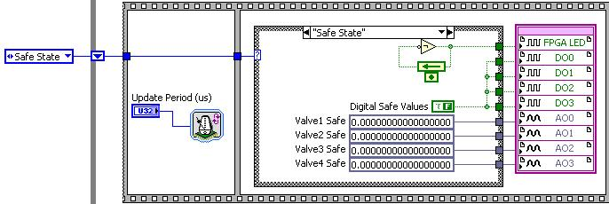
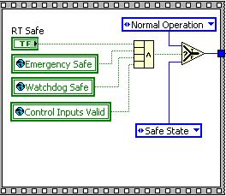
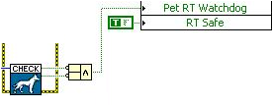
FPGA Safe States
P
O
A
N
Fail-Safe Control Reference Design
FPGA
RT
Notes:
There happens to be a reference design known as the Fail-Safe Control Reference Design that implements FPGA safe states! Use it!

Slide 49
RTEXE and FPGA Best Practices
P
O
A
N
RT Protocol
Disable or Firewall the RTProtocol
Enables LabVIEW to connect to a real-time target
Can be disabled through the ni-rt.ini file
RTTarget.RTProtocolAllowed=FALSE
Notes:
With regards to the real-time application, users should build the code into an RTEXE. There is a lot less overhead for an RTEXE compared to running the code from the development environment in interactive mode. More network overhead means more attack space/security vectors for attackers to take advantage of. Interactive mode is also not deterministic, and shouldn’t be used for the final deployment if the application has strict timing needs.
On the FPGA, there are a few measures which can be taken to boost security. The first is to implement bounds checking. This is basically having the I/O on the FPGA saturate so that even if there are erroneous messages from the host/rt, no damage is done to hardware downstream. Additionally, users can implement FPGA Safe States. The idea behind safe states is to have an FPGA watchdog over RT, and if the watchdog doesn’t return that everything on RT is well, then the FPGA goes into a safe default state. This way, no damage is done to hardware downstream if RT is corrupted.
In 2014, you can do this from MAX as a checkbox.

Slide 50
Check Understanding
What aspects of your system should you protect when implementing a security strategy?
I have disabled my FTP server on my VxWorks cRIO. Can I now assume my cRIO’s files cannot be accessed?
Notes:
Physical, network, OS, application
No. FTP server is enabled in safe mode. Disabling is only a minor determinant (slows attacker down)

Slide 51
4. Intermediate Security Considerations
Notes:
Now it’s onto the optional best practices. These are measures that take a little more time and effort, but which also provide a little more security. This is something that many users should consider as it addresses some of the vulnerabilities not addressed by the recommended set of practices.

Slide 52
Hardware Restrictions
P
O
A
N
Limit Physical
Access
Disable or Encrypt I/O
Limit environmental access to Host PC and physically enclose the cRIO
Disable unnecessary peripheral I/O on the cRIO and on the host (USB, CD Drive, etc.)
Notes:
The first optional practice is to disable or encrypt all the I/O on the host pc. This prevents portable media such as USB drives, CDs, DVDs etc which contain some malicious code from infecting the host pc and disrupting the application.
Additionally, it’s meaningful to physically contain the RIO target (for example, lock it in a box), and limit access to the host pc. Physical access to the RIO targets gives one the ability to reset the device, use console out, etc. to disrupt the application and try to steal/reverse engineer the application. Similarly, physical access to the host pc might allow an attacker to disrupt the application via the user interface on the host pc, etc. It’s important to ensure that only the people who are authorized to use the host application have access to the host pc physically.

Slide 53
Intermediate Best Practices
P
O
A
N
Firewall
VPN
Use a VPN tunnel to deploy code securely
Use the hardware firewall to filter out unused ports and monitor traffic
Securely access the RIO device from an external network
On NI Linux Real-Time, VPN and Firewall are available on-target
OpenVPN for VPN, IPTables for Firewall
Notes:
Additionally, given that the cRIO doesn’t have a built-in software firewall, one of the most useful steps is to invest in a VPN capable hardware firewall and host the RIO target behind the hardware firewall.
Using a VPN firewall allows one to securely deploy code, and monitor the network traffic coming into the RIO target. With a VPN firewall, users can also safely access the RIO device from an external network.

Slide 54
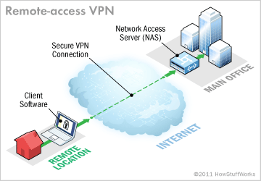
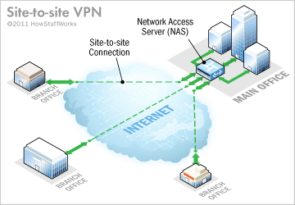
VPN
P
O
A
N
Virtual tunnel to securely transfer data over public infrastructure
Encapsulated data packets and tunneled interfaces
Remote Access: VPN SW on computers
Works well for smaller scale
Site to Site: Connect two LANs
Eliminates the need for custom SW
Notes:
This is a slide which elaborates about VPN. It’s a common name, but often times, people don’t understand that VPN is a concept, not a protocol. There are different types of VPNs, and they use different underlying techonlogies and protocols.

Slide 55
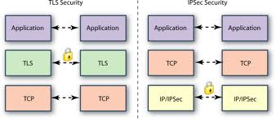
VPN Routers
P
O
A
N
VPN hardware is not created equal
Support varying number of VPN tunnels
Support varying protocols and functionality
Functionality: Site to Site vs. Remote Access
Protocols: IPsec, IPsec + L2TP, SSL
Setup can vary based on VPN type
Get IT/Network Admin assistance
Notes:
When investing in a VPN router, it’s thus important to consider the underlying technologies! Not all VPN routers are created equal, and some rely on more “secure” protocols (meaning harder to crack encryption) than other VPN routers, and may also provide more flexibility (such as number of VPN tunnels that it supports).
Take these factors into consideration when investing in a VPN router (the cheapest one isn’t necessarily the best option).

Slide 56
SSL Certificates
P
O
A
N
Signed SSL Certs
Don’t rely on the default (self-signed) certificate
Use a signed certificate from a Certificate Authority
Notes:
Another technique is to change the default ports for Application web server and other web servers. While it’s not tough for attackers to determine what port you may have moved the web servers to, when used in conjunction with a hardware firewall, this method provides an effective screen against many attacks.

Slide 57
Scan Mode
P
O
A
N
Avoid Scan Mode
Caution: Scan mode by default enables access to I/O data through Network Published Shared Variables
Can turn off network publishing of scan mode I/O
Notes:
Another technique is to change the default ports for Application web server and other web servers. While it’s not tough for attackers to determine what port you may have moved the web servers to, when used in conjunction with a hardware firewall, this method provides an effective screen against many attacks.
Use NPSV in the right places, be cautious about it.

Slide 58
5. Extreme Security Considerations
Notes:
These are extreme best practices which take a lot more time and effort. The benefit to security is incremental, and these are measures that shouldn’t be taken by most users. Even extremely security conscious users may benefit more by contacting National Instruments to scope out a more specific security solution.

Slide 59
Application Whitelisting
P
O
A
N
Software Checking
Whitelisting
Software checking: compute and verify checksums on key system files on the real-time system
Employ application whitelisting on the host pc
Notes:
On the host pc, users can run application whitelisting, which will be explained further in a moment. On the RIO device, users can implement software checking, in which a checksum for key system files such as the ni-rt.ini file is computed. The checksum can be compared against the value of the checksum taken in a known good state of the RIO device. This too will be discussed in greater detail in just a moment…

Slide 60
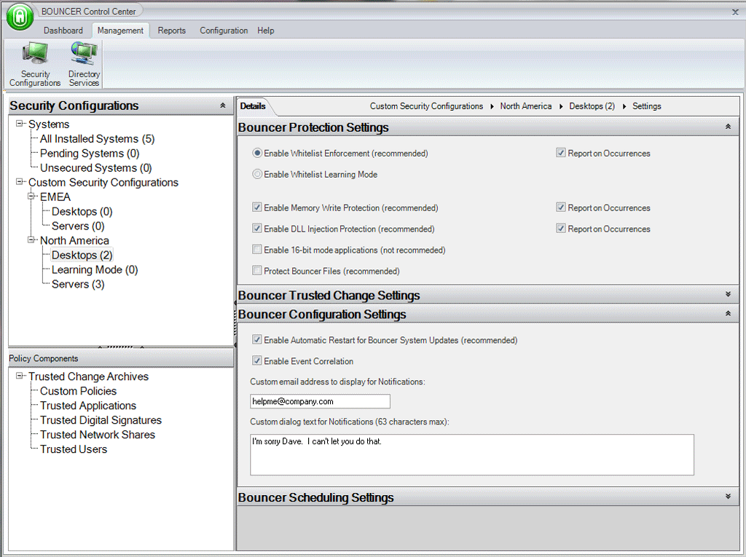
Application Whitelisting
P
O
A
N
Compute and store checksum in a known good state
Compare checksum against table
Solutions:
CoreTrace Bouncer
McAfee Application Control
Bit9 Parity Suite
Microsoft AppLocker
Notes:
Whitelisting is a concept that can consists of two parts.
1: Setup - during which the hash/checksum of all executables, binaries, and other runnable files is computed when the computer in a known good state.
2: Whitelisting Process - Once a table of all the checksums has been assembled, the whitelisting application can begin to police the computer. In this second part, any application which tries to run is checked by the whitelisting application. If the whitelisting application finds that the checksum of the application doesn't match a known checksum, the application is denied from running. In this way, whitelisting can ensure that the only things running on the computer are known to be benign.
The only drawback to whitelisting is cost and maintainability. In order to add a new application to the "acceptable list," one often has to go through some effort to roll back the whitelisting, modify the rules, and then re-enable the whitelisting. Various solutions provide different means of handling additions to the whitelisting rules, some easier than others.
Notable whitelisting solutions include: Bouncer from CoreTrace, Application Control from McAfee, Parity Suite from Bit9, and AppLocker from Microsoft.
Hooks into the system at the BIOS level. Cannot write yourself. Will prevent corrupt OS from even booting.

Slide 61
Software Checking
P
O
A
N
Requires a manual implementation on RT
During initialization of RT application, compute checksum on key system files
ni-rt.ini
Pass checksum to host or check against stored values on RT or USB
Notes:
Somewhat similar to whitelisting on a host pc, you can implement software checking on the real-time controller of the RIO device. The strategy is to compute the checksum of key system files on the real-time controller and check them at startup against the stored values.
A meaningful implementation would be to have the checksums computed and stored either on portable media, such as a USB drive, or on the host pc. The first step of the real-time application can be to compute the checksum of key files such as ni-rt.ini and return the value to the host pc for verification or to check the value against the value stored on removable media such as a USB drive plugged into the controller. If the checksum differs from the value previously computed, you know that something on the real-time controller has been modified and can investigate the change further and take action, such as to reformat the real-time controller.
For computing a checksum on key files, consider using the the MD5Checksum File.VI, which is a built in function which can run on LabVIEW Real-Time. You may also want to rely on tools already on the community such as the SHA-1 Cryptographic Hash Function.

Slide 62
Hardware Checking
P
O
A
N
Hardware Checking
Hardware Checking:
On RT, check for an encrypted USB or Serial dongle
On FPGA, check for specific signals
Good for IP protection
Notes:
In addition to whitelisting and software checking, users can also implement hardware checking and can encrypt communication.
As far as hardware checking goes, a good addition to locking the RIO device in an enclosure would be to have a signal from the locked enclosure fed into the RIO device. The FPGA can check for this hardware signal, and if different than expected, can alert the real-time controller and enter an FPGA safe state.
In addition to a signal from the locked enclosure, you may want to have the FPGA check for other signals related to hardware necessary for the application. If the signals fail to return proper values (such as digital HI, etc.), you will be able to tell that the hardware setup for the application was tampered with.
The implementation for hardware checking with change based on the application and the feedback signals that you incorporate into the locked enclosure and other required hardware elements.
Example: digital line represents opening of box. Concept of a trip wire.
For encrypting communication between RT and FPGA…

Slide 63
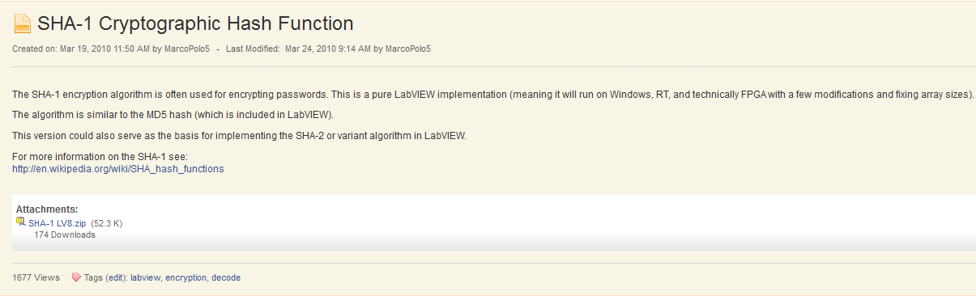
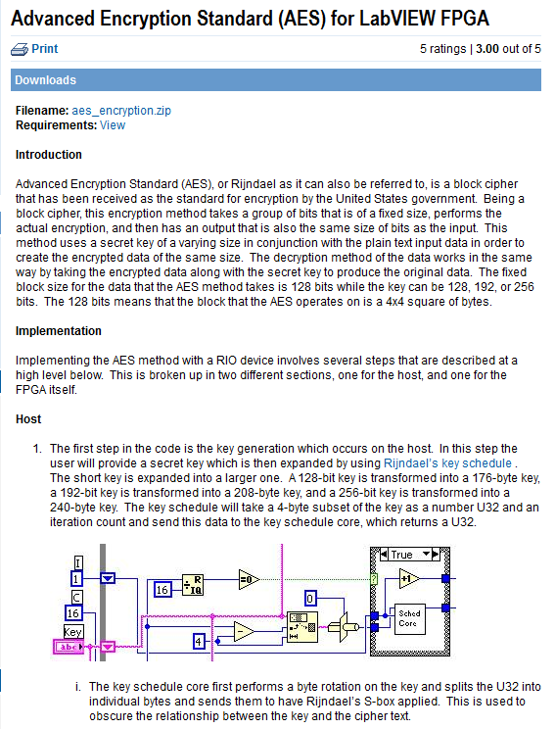
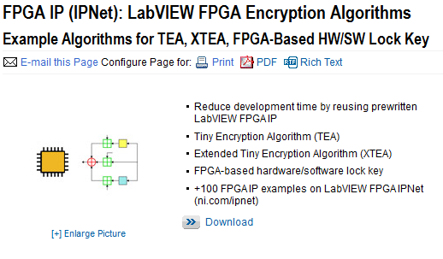
Encrypting RT/FPGA Communication
P
O
A
N
Notes:
… Rely on the protocols offered for free on Ipnet.
Honestly, this is a measuer to protect against the worst case scenario of an attacker gaining physical access to the RIO device and working to dismantle the device to reverse engineer the real-time application and the FPGA application. To protect from this, you can encrypt the communication between the real-time controller and the FPGA. This way, attackers trying to sniff the PCI bus which runs between the real-time controller and the FPGA will have a much harder time of trying to decode the application. This isn’t a common concern for many users.
As you can see, there are a variety of protocols that you can use to encrypt communication between the FPGA and real-time controller. For more information, please refer to FPGA IP (IPNet): LabVIEW FPGA Encryption Algorithms.
Other option: encrypt data on FPGA that you want to send over network. Offload computations, FPGAs are good at encryption and decryption.

Slide 64

Redundancy
Redundancy is a common approach to improve the reliability and availability of a system
Adding redundancy increases the cost and complexity of a system design and with the high reliability of modern electrical and mechanical components, many applications do not need redundancy in order to be successful.
However, if the cost of failure is high enough, redundancy may be an attractive option.

Slide 65


Types of Redundancy (1)
Types of Redundancy
Standby (Backup) Redundancy
Identical secondary unit to back up the primary unit
The secondary unit typically does not monitor the system, but is there just as a spare
Cold Standby:
the secondary unit is powered off, thus preserving the reliability of the unit
Hot Standby:
the secondary unit is powered up and can optionally monitor the DUC
See Redundant System Reference Design for LabVIEW Real Time, LabVIEW FPGA, and CompactRIO
Notes:
[Reference] http://www.ni.com/white-paper/6874/en/
In cold standby, the secondary unit is powered off, thus preserving the reliability of the unit.
In hot standby, the secondary unit is powered up and can optionally monitor the DUC.

Slide 66
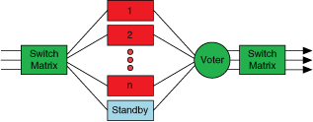
Types of Redundancy (2)
Types of Redundancy
N Modular (Parallel) Redundancy
Multiple units run in parallel
All units are highly synchronized and receive the same input information at the same time
Their output values are then compared and a voter decides which output values should be used
Dual, Triple, Quadruple
1:N Redundancy
Single backup for multiple systems
Works well for primary units that similar functions
Notes:
[Reference] http://www.ni.com/white-paper/6874/en/
In cold standby, the secondary unit is powered off, thus preserving the reliability of the unit.
In hot standby, the secondary unit is powered up and can optionally monitor the DUC.

Slide 67
Check Understanding
Every Tuesday at 3 o’clock, my factory has a group of kids visit. How do I protect my critical system from damage?
My competitor’s plant is right next door to mine, and I’m worried about them trying to sabotage my line. What can I do?
Notes:
These are intended as discussion questions to make sure students understand the concepts.
This question to focused on protecting a mission-critical system from unintended damage. Answer may include hardware security, I/O checking, etc.
This question is focused on protecting a system from intentional attacks. Answers many be related to network security. Disable FTP, firewall, vpn, etc.

Slide 68
Conclusion
Define security requirements for your application
Understand the implications of general, intermediate, and extreme security considerations
Performance
Process
Complexity

